Slide 1

FoodRescue AI: Autonomous Surplus-Food Detection & Redistribution Agent
SOA Project Review-2
26-09-2026
 | Under the Guidance of Dr. K. Venkateswari Professor, Department of Computer Science and Engineering, KLH CSE Bowrampet Campus
Team Members P. Poojith Varma 2420030749 G. Prashanth Kumar 2420090072 V. Harshith Varma 2420030020

Slide 2
Outline of Project Work
Problem Statement
Objectives
Literature Survey
Problem Gap Identification
Innovation, Creativity, and Novelty
Feasibility and Project Plan
Conclusion & Future Work
References
Publications Details

Slide 3
Problem Statement
Large quantities of edible food are often left unused in canteens, restaurants, hotels, and events, while organizations and communities may simultaneously need food resources. Existing food donation systems generally depend on manual reporting, recipient selection, and pickup coordination, which can cause delays and inefficient redistribution.
There is a need for an AI-based autonomous system that can analyze surplus-food information, assess its urgency and suitability, intelligently match it with appropriate recipients, prioritize redistribution, and assist in coordinating pickup and delivery through a scalable SOA-based architecture.
Problem in the Current Process
• Manual surplus-food reporting
• Time-consuming recipient identification
• No intelligent redistribution prioritization
• Manual pickup coordination
• Risk of delays and food wastage

Slide 4
Objectives
Develop an AI-based autonomous system for managing surplus-food redistribution.
Analyze surplus-food information such as food category, quantity, urgency, and suitability.
Intelligently match available surplus food with suitable nearby recipients based on their requirements.
Prioritize redistribution requests based on factors such as urgency, quantity, suitability, and location.
Automate notifications and assist in coordinating food pickup and redistribution.
Track the status of the redistribution process from food submission to successful recovery.
Implement the system using a scalable SOA-based microservices architecture.
Evaluate the system based on redistribution efficiency, response time, matching accuracy, and successful food recovery.

Slide 5
Literature Survey
Authors | Title of the Paper | Methodology | Inferences | Limitation/Future work
Caleb Phillips et al. | Food Redistribution as Optimization, PLOS ONE, 2013 | Empirical modeling and Monte Carlo simulation for food rescue and redistribution | Shows that food rescue and redistribution can be feasible at small and large scales. | Depends on fast transportation and redistribution before food expires; does not provide an autonomous AI system.
Miguel Rodrigues et al. | Machine Learning Models for Short-Term Demand Forecasting in Food Catering Services: A Solution to Reduce Food Waste, Journal of Cleaner Production, 2024 | Random Forest, LSTM and other machine-learning models for demand forecasting | ML-based forecasting can help reduce food waste by improving food-demand prediction. | Focuses on preventing overproduction through forecasting rather than redistributing existing surplus food.
T. Sunil Kumar et al. | An Intelligent Platform for Surplus Food Management Using Machine Learning, 2026 | Machine learning combined with rule-based decision systems | Uses ML for food sharing, expiry prediction and priority classification. | Does not provide the complete autonomous agent workflow and SOA-based microservice coordination proposed in FoodRescue AI.

Slide 6
Problem Gap Identification
Problem Gap Identification
• Existing food redistribution approaches mainly focus on donation management, optimization, or basic coordination rather than autonomous decision-making.
• Existing machine learning approaches mainly focus on food-waste prediction or demand forecasting, but do not fully address real-time surplus-food redistribution.
• Current digital platforms provide features such as food listing, recipient requests, pickup scheduling, and tracking, but intelligent recipient matching and redistribution prioritization are limited.
• There is a lack of an integrated AI Agent that can analyze surplus food, assess urgency and suitability, select suitable recipients, prioritize requests, and assist in pickup coordination.
• Existing solutions do not provide a complete combination of autonomous AI decision-making with a scalable SOA-based microservices architecture.
Identified Gap
FoodRescue AI aims to bridge this gap by integrating AI-based analysis, intelligent recipient matching, redistribution prioritization, autonomous coordination, and SOA-based microservices into a single system.
This gap is consistent with the literature: food-rescue research highlights the importance of quick redistribution, while newer platforms still identify automated matching, notifications, safety controls, and real-time tracking as areas for further development.

Slide 7
Innovation, Creativity, and Novelty
Innovation, Creativity, and Novelty
Agentic Surplus-Food Intelligence
The AI Agent analyzes submitted surplus-food information including food category, quantity, urgency, and suitability, and autonomously determines the next action.
Context-Aware Recipient Matching and Priority
The system combines food type, quantity, urgency, recipient requirements, location, and availability to recommend suitable recipients and prioritize redistribution requests.
Autonomous SOA-Based Redistribution Orchestration
The AI Agent coordinates multiple microservices such as Food, Matching, Redistribution, and Notification Services to manage the workflow from surplus submission to successful food recovery.
Key Innovation
FoodRescue AI combines AI-based decision-making, autonomous workflow orchestration, intelligent matching, and SOA-based microservices into one end-to-end surplus-food redistribution system.
This is stronger than simply saying “AI matching is our novelty,” because existing food-rescue systems already use AI matching

Slide 8
Feasibility and Project Plan
Technical Feasibility
• Uses Python, FastAPI, AI/ML services, databases, APIs, and microservices.
• SOA-based architecture allows independent development and integration of services.
• AI Agent Service can be integrated with an AI model for intelligent analysis and decision-making.
Operational Feasibility
• Food providers can submit surplus-food details through the application.
• Recipient organizations can receive suitable food requests and coordinate pickup.
• The system supports automated matching, prioritization, notifications, and status tracking.
Economic Feasibility
• Uses open-source technologies and available cloud services.
• The modular architecture supports future expansion with minimal changes.
Project Plan
• Phase 1: Requirements & Literature Survey
• Phase 2: SOA Architecture & System Design
• Phase 3: Microservices Development
• Phase 4: AI Agent Development & Integration
• Phase 5: Matching & Notification
• Phase 6: Integration & Testing
• Phase 7: Deployment & Evaluation
• Phase 8: Documentation & Presentation

Slide 9
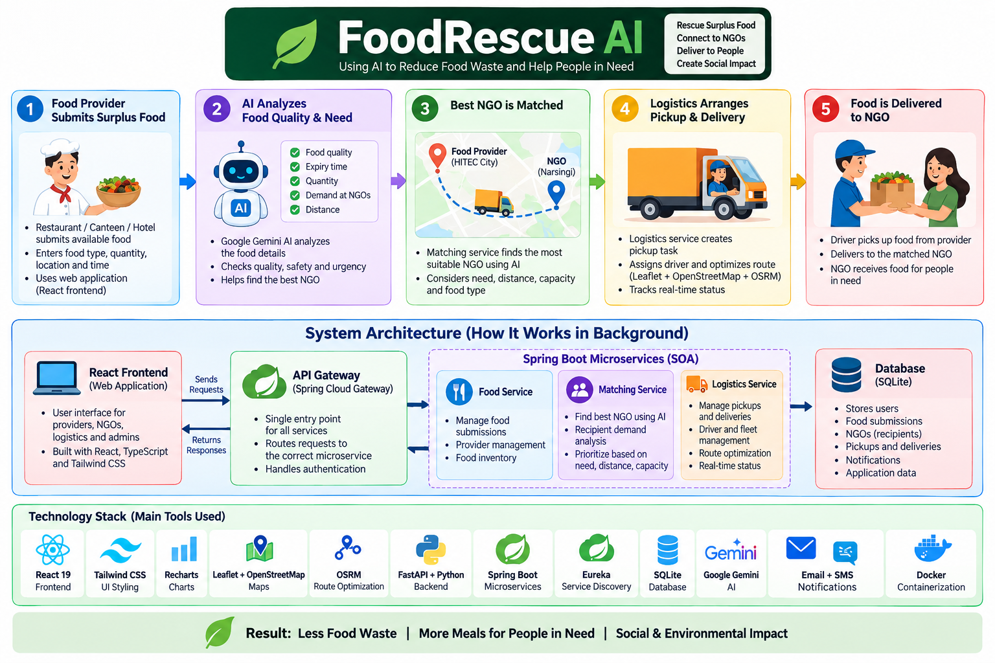

Slide 10
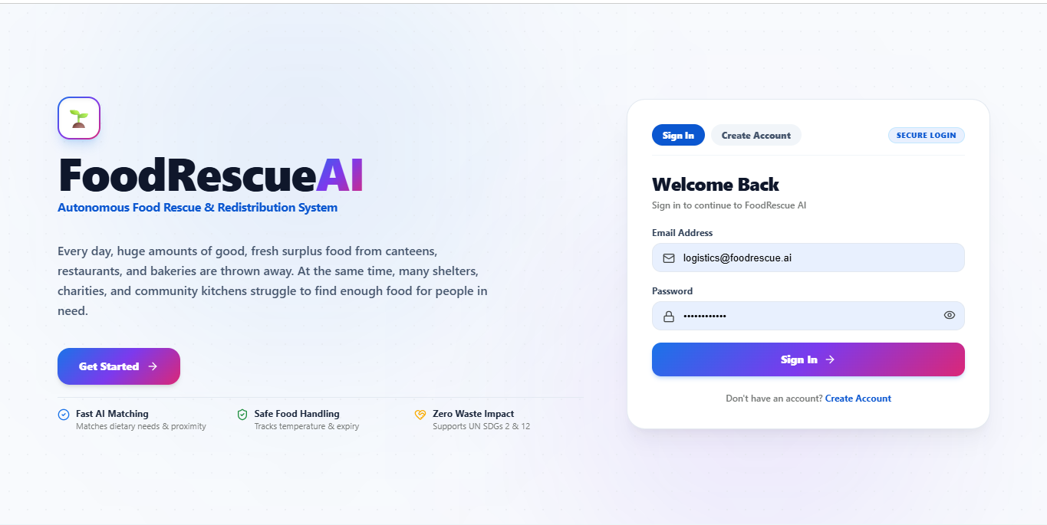

Slide 11
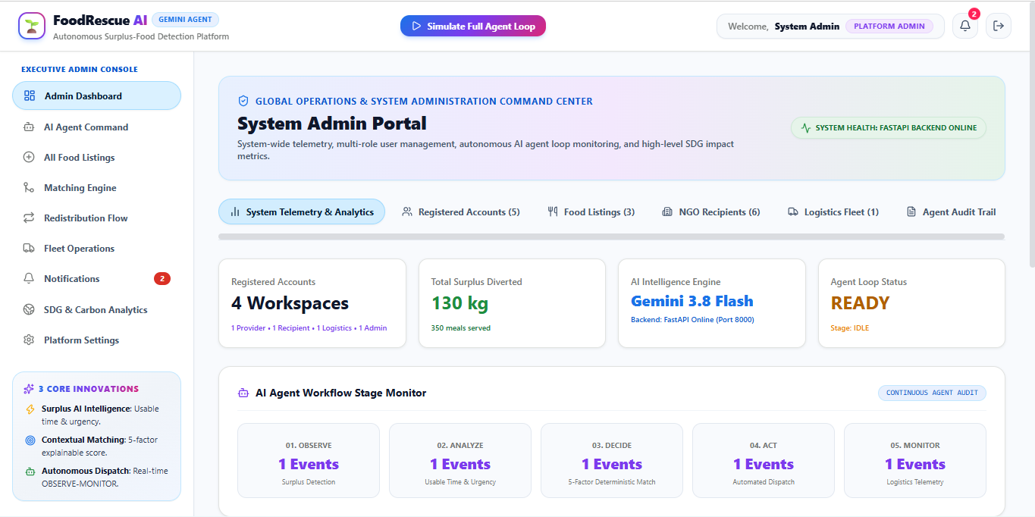

Slide 12
THANK YOU

